Slide 1
OfficerReports.com
Security Guard
Management Software

Slide 2
SECURITY OFFICER INFORMATION
Collect
Deliver
Access

Slide 4
Are you still using paper?

Slide 5
CLIENT BENEFITS
MINIMIZE PAPERWORK
SAVE
TIME
MANAGE INCIDENTS
REAL-TIME
MONITORING

Slide 7
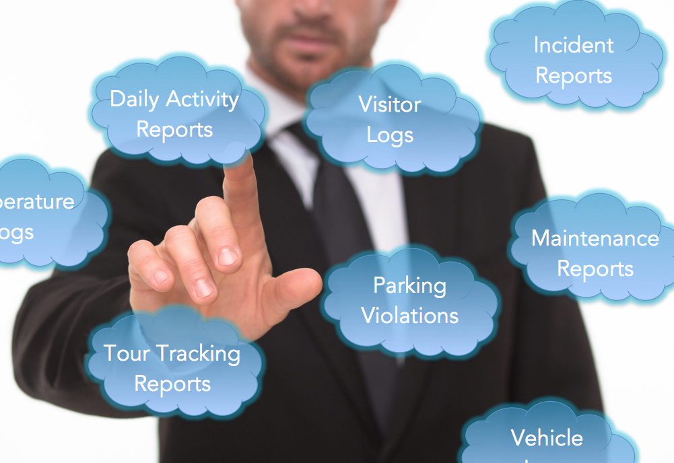
Reports Delivered via the Web

Slide 8
MINIMIZE PAPERWORK
SAVE
TIME
MANAGE INCIDENTS
REAL-TIME
MONITORING

Slide 9
Save Time

Slide 10
All Security Related
Information In One Place

Slide 11
MINIMIZE PAPERWORK
SAVE
TIME
MANAGE INCIDENTS
REAL-TIME
MONITORING

Slide 12
Minimize Paperwork

Slide 13
MINIMIZE PAPERWORK
SAVE
TIME
MANAGE INCIDENTS
REAL-TIME
MONITORING

Slide 14
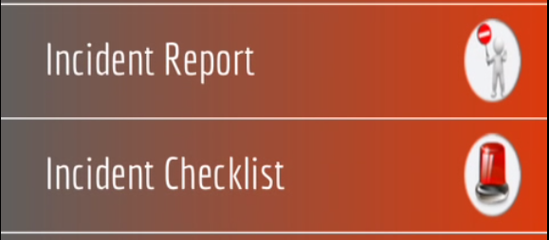
Manage Incidents

Slide 15
REDUCE
SHRINK
MINIMIZE
MITIGATE
DECREASE
DIMINISH

Slide 16
MINIMIZE PAPERWORK
SAVE
TIME
MANAGE INCIDENTS
REAL-TIME
MONITORING

Slide 17
Real Time Monitoring

Slide 18
Real Time Monitoring

Slide 19
COMPREHENSIVE SECURITY GUARD MANAGEMENT
Daily Activity Reports
Incident Reports
Incident Checklist
Pass On Log
Truck Log
Visitor Log
Post Orders
Policy Manual
Vacation Request
Parking Violation Log
Equipment Temperature Log
Maintenance Requests
Real-Time GPS Based Tour Tracking
Clock In/Out Verification

Slide 20
QUESTIONS?

